Slide 1
Welcome to the
JA Staff Alumni Network… a Pioneer legacy
Annual Meeting

Slide 2
Today’s Agenda
Reports on 2022-23 Goals & Accomplishments
Fund Campaign
Communications
Recognition & Development
Membership
Approval of 2023-24 Officers & Operating Budget
2023-24 Program of Work

Slide 3
2023-24 Program of Work
Support JA USA
Staff Development and Recognition
> Karl Flemke Award
> Jim Sweeny Entrepreneurial Excellence Award
> NLC Scholarships
Professional Staff Hall
of Fame
Use each of our electronic platforms to enhance membership connections
Ensure the Website stays up to date with information seen as valuable to members.
Use Facebook for everyday connections among our members, including “meet-ups”.
Use LinkedIn to help members find professional and volunteer opportunities.
Use our periodic newsletters to provide information about JASAN, JAUSA, and our members.
Keep the History of JA alive and easily accessible
Increase the number of oral histories available through the Junior Achievement archives.
Identify individuals who should be interviewed for the archives.
Work with JA USA to determine how the JA Museum can be seen by more people.
Add historical information to the JASAN website.
Ensure sufficient funding to carry out the work of the organization
Raise funds from members and other appropriate sources to fund the work of the organization.

Slide 4
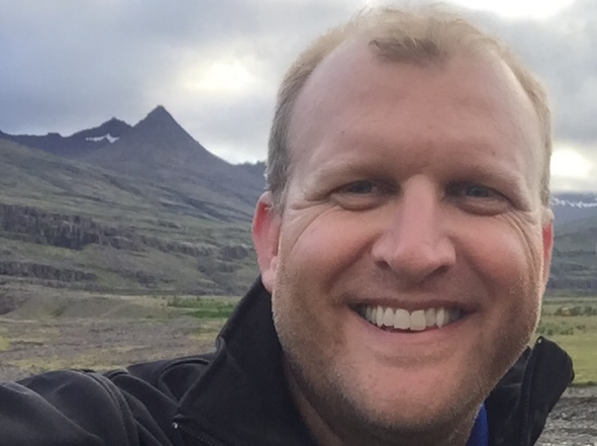
Fund Development Committee Brad Kaufmann, Chair

Slide 5
Committee Members
➢
The mission of the JA Staff Alumni Network is to provide a network
for alumni and to further the mission of JA USA.

Slide 6
Committee Goals
➢
The mission of the JA Staff Alumni Network is to provide a network
for alumni and to further the mission of JA USA.

Slide 7
Committee Accomplishments
➢
The mission of the JA Staff Alumni Network is to provide a network
for alumni and to further the mission of JA USA.

Slide 8
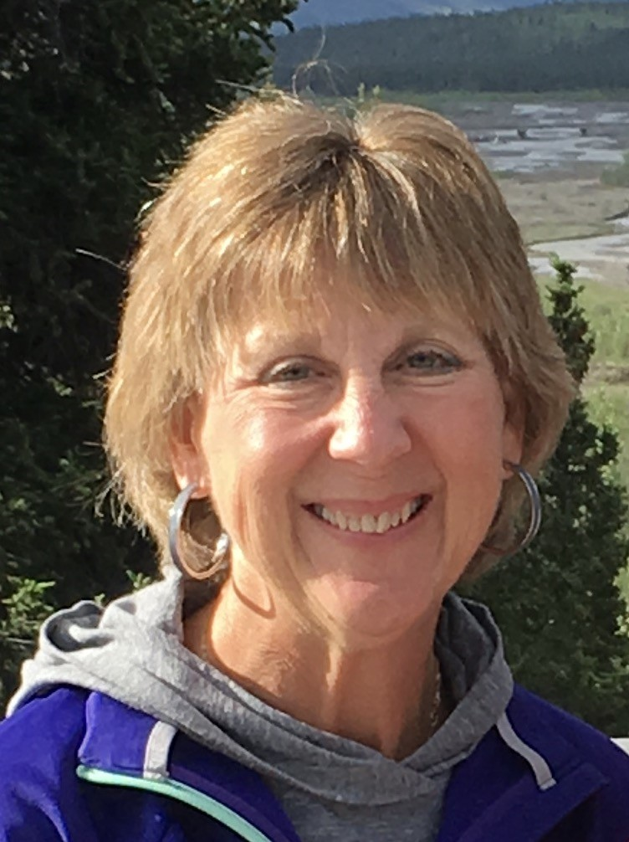
Communications Committee
Linda Schoelkopf, Chair

Slide 9
Committee Members
➢
The mission of the JA Staff Alumni Network is to provide a network
for alumni and to further the mission of JA USA.

Slide 10
Committee Goals
➢
The mission of the JA Staff Alumni Network is to provide a network
for alumni and to further the mission of JA USA.

Slide 11
Committee Accomplishments
➢
The mission of the JA Staff Alumni Network is to provide a network
for alumni and to further the mission of JA USA.

Slide 12
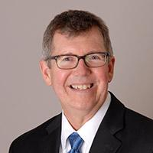
Recognition & Development Committee
Randal Mays, Chair

Slide 13
Committee Members
➢
The mission of the JA Staff Alumni Network is to provide a network
for alumni and to further the mission of JA USA.

Slide 14
Committee Goals
➢
The mission of the JA Staff Alumni Network is to provide a network
for alumni and to further the mission of JA USA.

Slide 15
Committee Accomplishments
➢
The mission of the JA Staff Alumni Network is to provide a network
for alumni and to further the mission of JA USA.

Slide 16
Video of Sweeny Award Winner

Slide 17
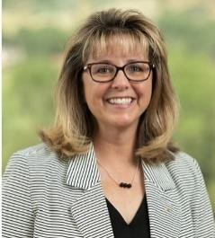
Membership Committee
Tami Godsey, Chair

Slide 18
Committee Members
➢
The mission of the JA Staff Alumni Network is to provide a network
for alumni and to further the mission of JA USA.

Slide 19
Committee Goals
➢
The mission of the JA Staff Alumni Network is to provide a network
for alumni and to further the mission of JA USA.

Slide 20
Committee Accomplishments
➢
The mission of the JA Staff Alumni Network is to provide a network
for alumni and to further the mission of JA USA.

Slide 21
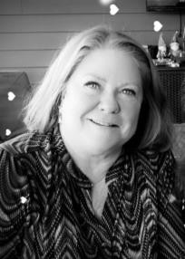
History Committee Sally Stamper, Chair

Slide 22
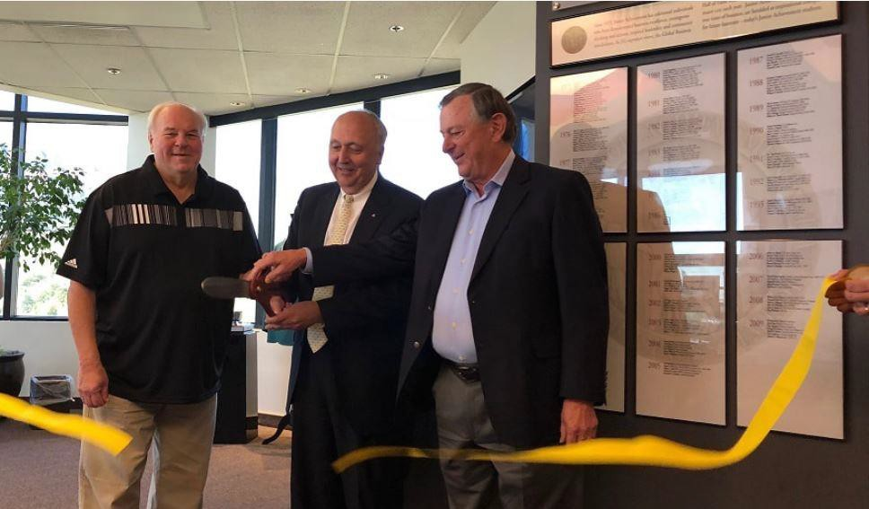
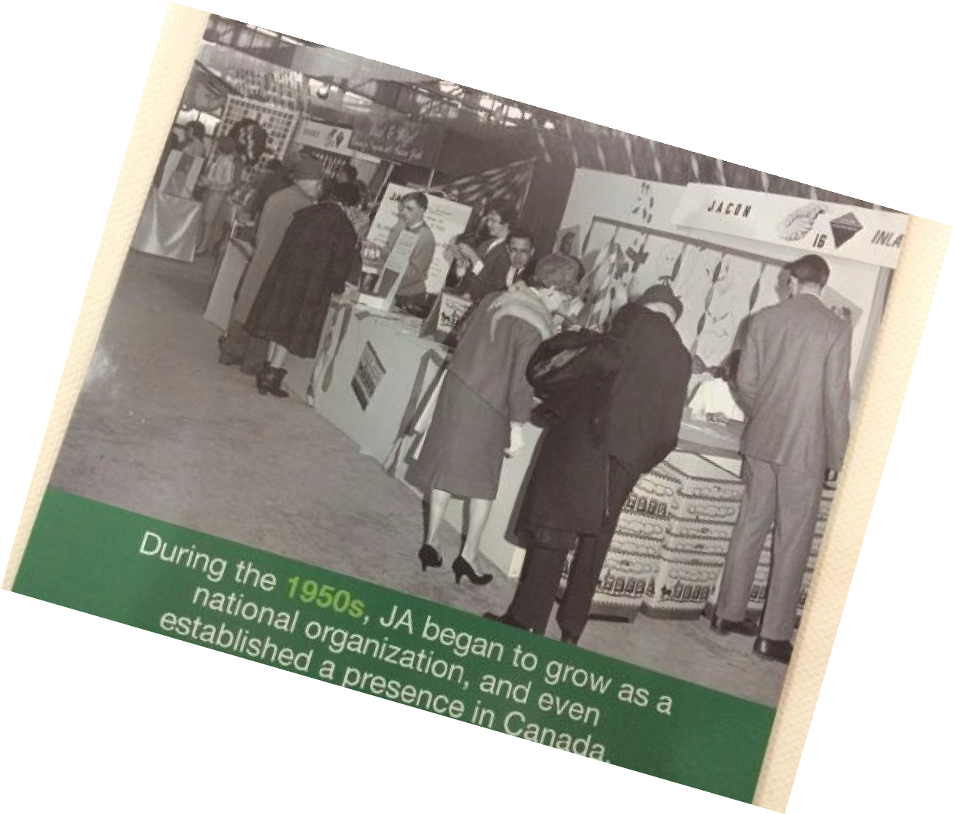
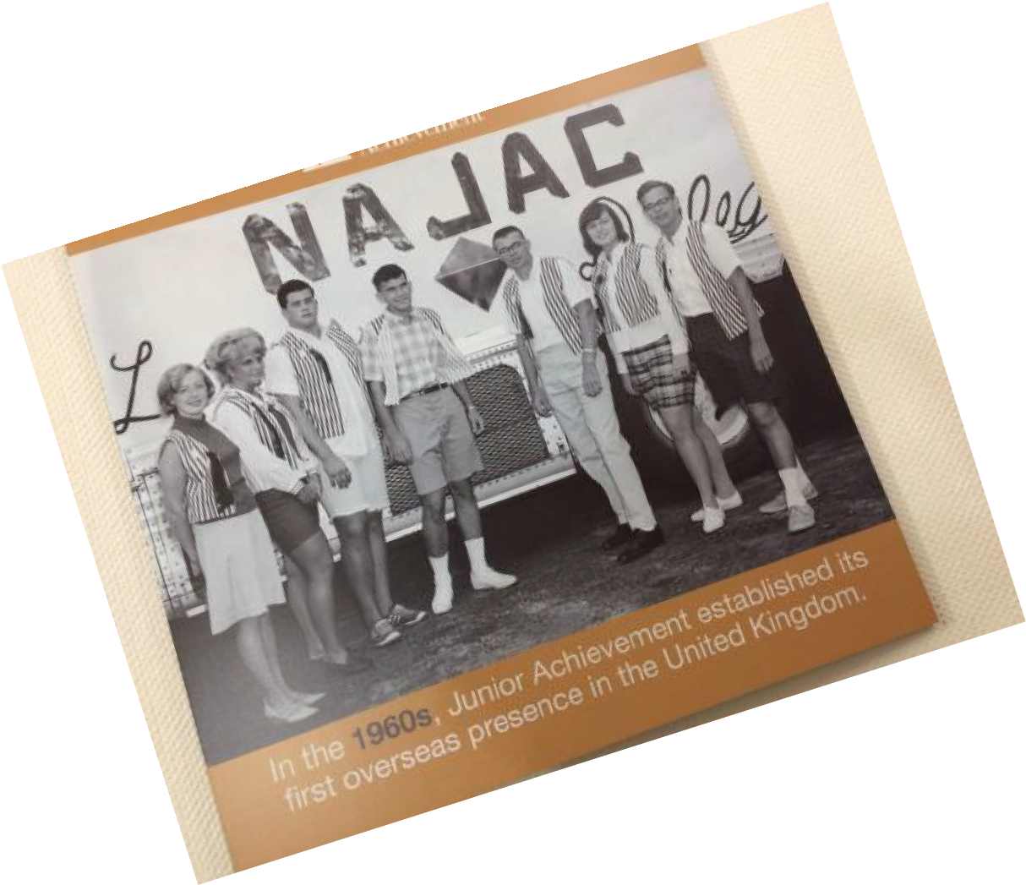
Preserving Our History

Slide 23
Committee Members
➢
The mission of the JA Staff Alumni Network is to provide a network
for alumni and to further the mission of JA USA.

Slide 24
Committee Goals
➢
The mission of the JA Staff Alumni Network is to provide a network
for alumni and to further the mission of JA USA.

Slide 25
Committee Accomplishments
➢
The mission of the JA Staff Alumni Network is to provide a network
for alumni and to further the mission of JA USA.

Slide 26
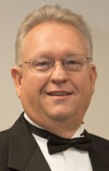
Election of Officers John Weil, JASAN Chair

Slide 27
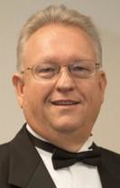
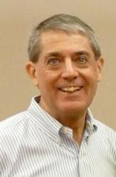
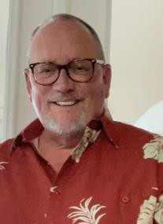
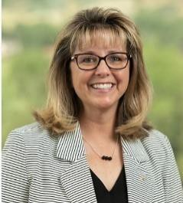
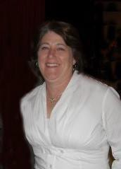
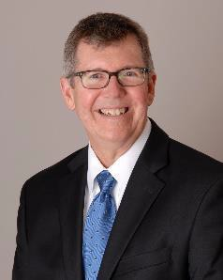
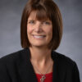
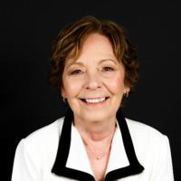
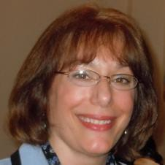
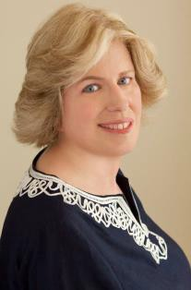
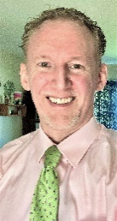
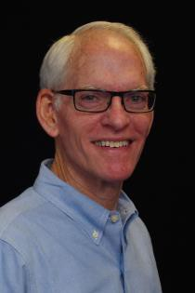
Election of 2023-24 Officers, Committee Chairs, and At Large Members
Linda Schoelkopf
Chair, JASAN
John Weil
Past Chair
Frank Evans
Administration
Dennis Gilfoyle
Chair, Fund Development
Tami Godsey
Chair, Membership
Nancy Finke
Chair, Finance
Randal Mays
Chair, Staff HOF
Theo Boots
Chair, Engagement
Sally Stamper
Chair, History
Pamela Casteel
Chair, Archives
Lucy O’Donnell
Chair, Staff Development & Recognition
Laurie Stearn
At Large
Greg Munson
At Large
Hud Whitenight
Admin

Slide 28
2022-23 Operating Budget
Nancy Finke, Chair
The mission of the JA Staff Alumni Network is to provide a network
for alumni and to further the mission of JA USA.

Slide 29
2021/22 Fund Balance Report
Interim Report for the Period Ending June 30, 2022

Slide 30
2023 Member Voting Results
for
Executive Committee and
Operating Budget
John Weil, Chair, JASAN
The mission of the JA Staff Alumni Network is to provide a network
for alumni and to further the mission of JA USA.

Slide 31
Results of 2023 Member Voting
 | Approval of 2023-24 Executive Committee | Approval of 2023-24 Operating Budget | Approval of Hudson Whitenight as Proxy
# Votes in Favor (electronic votes) (mailed votes) | # # | # # | # #
# Votes Opposed (electronic votes) (mailed votes) | # # | # # | # #

Slide 32
2023-24 Program of Work
graphic
John Weil, Chair, JASAN
The mission of the JA Staff Alumni Network is to provide a network
for alumni and to further the mission of JA USA.

Slide 33
Supporting JA USA
SUPPORT LOCALLY TO IMPACT NATIONALLY.
Sponsor the Jim Sweeny Scholarship and Karl Flemke Award
Provide 50 scholarships for JA area staff to attend the 2023 NLC
Develop, in partnership with JA USA, expectations for connection and follow-up among scholarship recipients and JASAN scholarship contributors
KEEP THE HISTORY OF JA ALIVE AND EASILY AVAILABLE TO ALL.
Transcribe and post Oral histories to the JASAN website
Support the JA Archives
Define a process, consistent with the JA USA-JASAN MOU, for transmission of historically significant documents to the IUPUI Archives
Support the JA Museum
Support JA USA in the collection and preservation of materials to be maintained in the Museum (physical/virtual) after the JA Headquarters building is sold
The mission of the JA Staff Alumni Network is to provide a network
for alumni and to further the mission of JA USA.

Slide 34
2023 Member Voting Results
2023-24 Program of Work
John Weil, Chair, JASAN
The mission of the JA Staff Alumni Network is to provide a network
for alumni and to further the mission of JA USA.

Slide 35
Results of 2023 Member Voting
 | Approval of 2023-24 Program of Work
# Votes in Favor (electronic votes) (mailed votes) | # #
# Votes Opposed (electronic votes) (mailed votes) | # #

