Slide 1
Welcome to the
JA Staff Alumni Network… a Pioneer legacy
Annual Meeting

Slide 2
JA USA Updates

Slide 3
Jack Kosakowski – JA USA
Richard George – 3DE Beth Beene – Brand MC Desrosiers &
Kristina Cassidy – Education & Impact

Slide 4
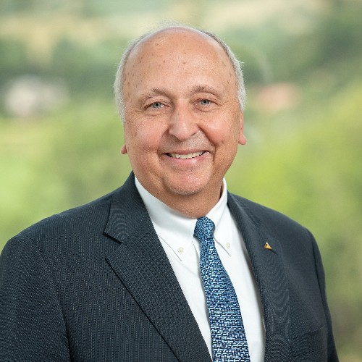
Jack Kosakowski President and CEO

Slide 5
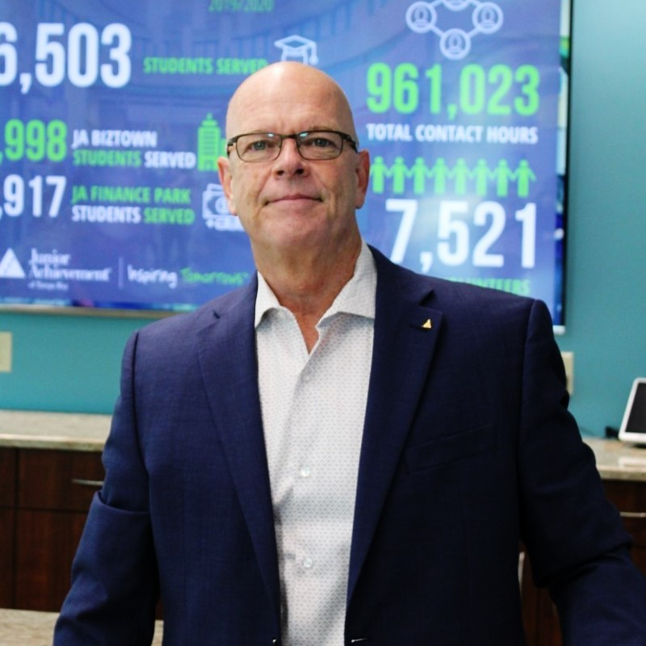
Richard George President Tampa

Slide 7
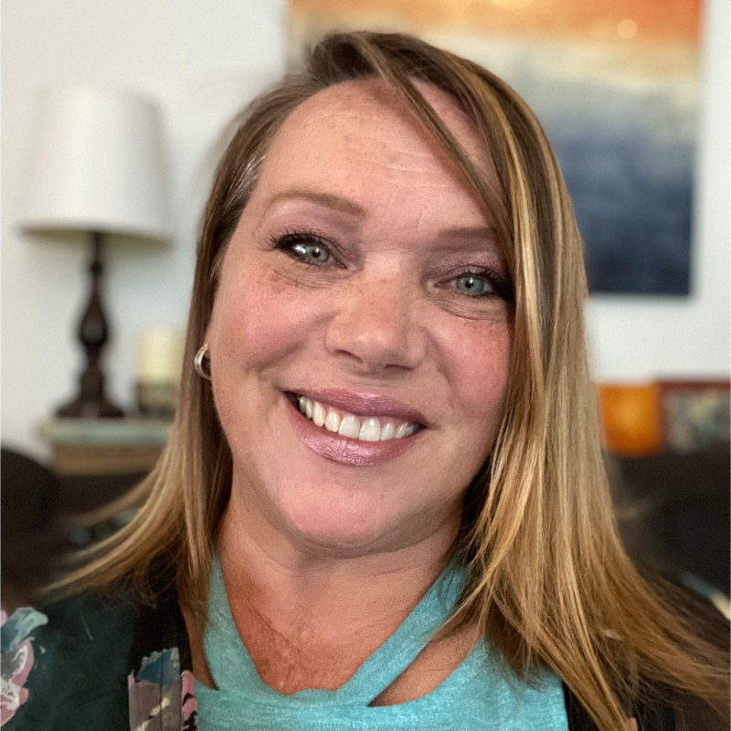
Beth Beene Vice President Marketing

Slide 8
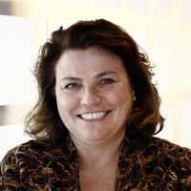
MC Desrosiers Chief Education and Learning Technologies Officer

Slide 9
Kristina Cassidy TBD
picture

Slide 10
Join Us Tonight at the
JASAN Reception

Slide 11
Welcome back
JA Staff Alumni Network…
a Pioneer legacy
Annual Meeting

Slide 12
Today’s Agenda
Reports on 2021-22 Goals & Accomplishments
Fund Campaign
Communications
Recognition & Development
Membership
Approval of 2023 Officers & Operating Budget
2022-23 Program of Work

Slide 13
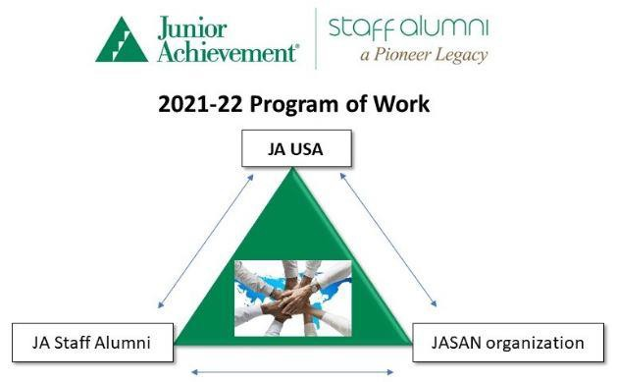
Randal Mays – Staff
Development & Recognition
Jean Richcreek – History
Linda Schoelkopf
– Communications
Tami Godsey – Membership Brad Kaufmann –
Fund Development

Slide 14
Fund Development Committee Brad Kaufmann, Chair
picture

Slide 15
Committee Members
➢

Slide 16
Committee Objectives
➢

Slide 17
Committee Accomplishments
➢

Slide 18
Communications Committee
Linda Schoelkopf, Chair
picture

Slide 19
Committee Members
➢

Slide 20
Committee Objectives
➢

Slide 21
Committee Accomplishments
➢

Slide 22
Recognition & Development Committee
Randal Mays, Chair
picture

Slide 23
Committee Members
➢

Slide 24
Committee Objectives
➢

Slide 25
Committee Accomplishments
➢

Slide 27
Membership Committee
Tami Godsey, Chair
picture

Slide 28
Committee Members
➢

Slide 29
Committee Objectives
➢

Slide 30
Committee Accomplishments
➢

Slide 32
History Committee Jean Richcreek, Chair ?????
picture

Slide 33
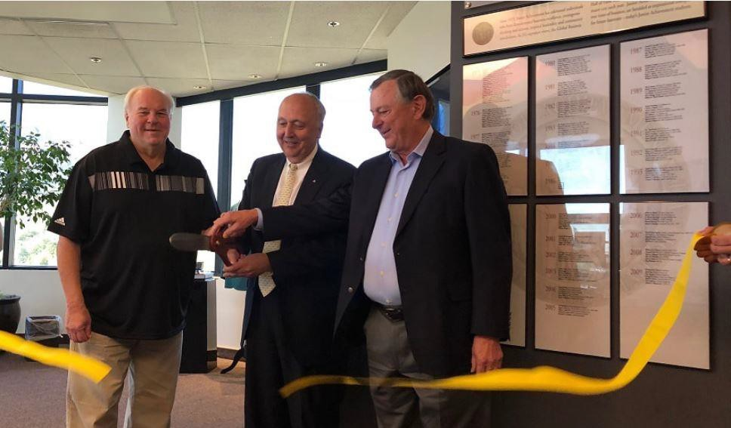
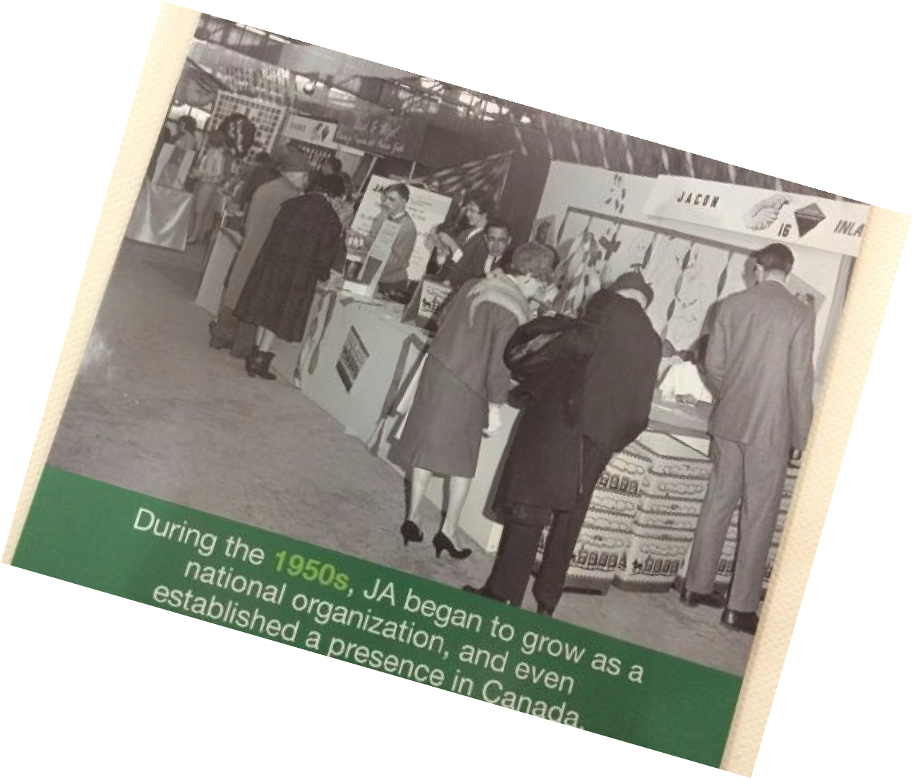
Preserving Our History

Slide 34
Election of Officers John Weil, JASAN Chair
picture

Slide 35
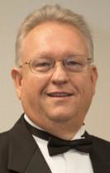
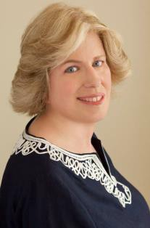
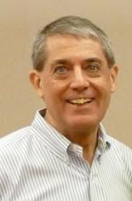
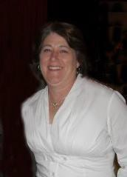
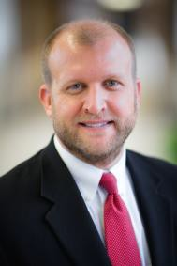
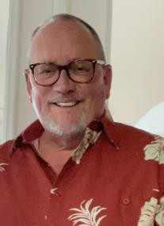
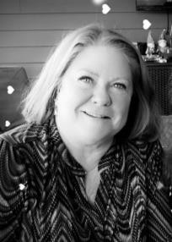
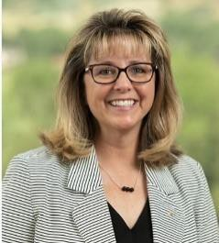
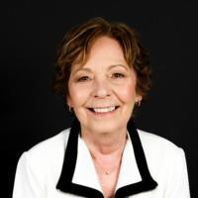
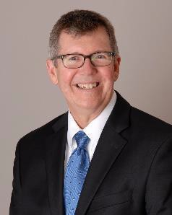
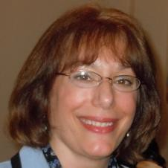
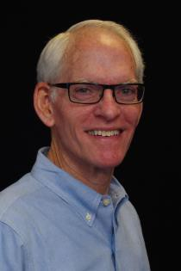
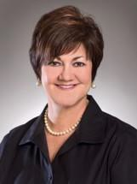
Election of 2022-23 Officers, Committee Chairs,
and At Large Members

Slide 36
Slate of Officers
John Weil, Chair, JA Staff Alumni Network
Linda Schoelkopf, Vice Chair, Chair-elect, Chair, Nominating Committee
Frank Evans, Administration
Hudson Whitenight, Secretary

Slide 37
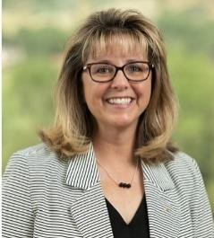
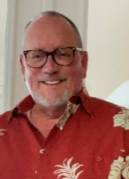
Committee Chairs
Laurie Stearn, Chair, Digital Communications
Tami Godsey, Chair, Membership
Dennis Gilfoyle, Chair, Engagement

Slide 38
Committee Chairs
Sally Stamper, Chair, History
Pamela Casteel, Chair, Archives
Randal Mays, Chair, Staff Development & Recognition

Slide 39
At Large Members
Lucy O’Donnell
Kathy Arnes

Slide 40
2022-23 Operating Budget
Ray Darby, Chair

Slide 41
2021/22 Fund Balance Report
Interim Report for the Period Ending June 30, 2022
 | JASAN Membership Fund | Karl Flemke Fund | Heritage Fund
Beginning Balance | $211,357 | $25,000 | $46,386
Funding Campaign | 54,311
YTD Expenses | (9,063) | (218) | (497)
Investment Earnings | (15,747) | (2,779) | (3,535)
Current Fund Balance | $240,758 | $22,003 | $42,354
JA USA scholarship pledge | 175,000
Available fund balance | $65,758

Slide 42
Proposed 2022/23 Operating Budget
Interim Report for the Period Ending June 30, 2022
 | 2021/22 Budget | 2021/22 Through 6/30 | Proposed 2022/23 Budget
Revenue | $28,819 | $28,819 | $18,333
SOS Campaign Reserves |  |  | 75,000
Available Funds |  |  | $93,333
Expenses | $18,994 | $ 9,063 | $91,447
Net Surplus (Deficit) | $ 9,825 | $19,756 | $ 1,886
Operating Expense Detail
Chairman | $7,553 | $3,340 | $7,872
Administrative Support | $4,000 | $1,500 | $2,625
Subscriptions | $2,003 | $ 602 | $2,125
Contingency | $1,050 | $1,238 | $1,200
National Leadership Conference | $ - | $ - | $1,422
Annual Meeting | $ 500 | $ - | $ 500

Slide 43
Proposed 2022/23 Operating Budget
Interim Report for the Period Ending June 30, 2022
 | 2021/22 Budget | 2021/22 Through 6/30 | Proposed 2022/23 Budget
Operating Expense Detail (cont.)
Awards & Recognition | $1,000 | $ - | $ 2,000
Staff Development | $ - | $ - | $75,000
Membership & Fundraising | $6,040 | $ 2,244 | $ 2,675
Communications | $4,401 | $ 3,479 | $ 3,900
Total of all detail | $18,994 | $9,063 | $91,447
Total Operating Expenses | $18,994 | $9,063 | $91,447

Slide 44
2022 Member Voting Results
for
Executive Committee
Operating Budget
John Weil, Chair, JASAN

Slide 45
Results of 2022 Member Voting
 | Approval of 2022-23 Executive Committee | Approval of 2022-23 Operating Budget | Approval of Hudson Whitenight as Proxy
# Votes in Favor (electronic votes) (mailed votes) | # # | # # | # #
# Votes Opposed (electronic votes) (mailed votes) | # # | # # | # #

Slide 46
2022-23 Program of Work
John Weil, Chair, JASAN

Slide 47
Supporting JA USA
SUPPORT LOCALLY TO IMPACT NATIONALLY.
Sponsor the Jim Sweeny Scholarship and Karl Flemke Award
Provide 50 scholarships for JA area staff to attend the 2023 NLC
Develop, in partnership with JA USA, expectations for connection and follow-up among scholarship recipients and JASAN scholarship contributors
KEEP THE HISTORY OF JA ALIVE AND EASILY AVAILABLE TO ALL.
Transcribe and post Oral histories to the JASAN website
Support the JA Archives
Define a process, consistent with the JA USA-JASAN MOU, for transmission of historically significant documents to the IUPUI Archives
Support the JA Museum
Support JA USA in the collection and preservation of materials to be maintained in the Museum (physical/virtual) after the JA Headquarters building is sold

Slide 48
Engaging JA Staff Alumni
DIGITAL COMMUNICATIONS
Provide members the information they need to connect with others
Develop various digital strategies based on the demographics of our members
Using various social media tools such as Facebook, LinkedIn, and Instagram
Electronic and hard copy communication
Ensure the new website provides reasons for members to visit
ENGAGEMENT
Provide members with meaningful opportunities to connect and engage with former JA colleagues
Establish a process to continue engagement with current members via social media, newsletter member spotlights, Zoom/online gatherings, local/regional gatherings as feasible/permitted
National JASAN meeting
Local/Regional in-person meetings
Video connections

Slide 49
Building the JA Staff Alumni Network
Organization
MEMBERSHIP
Use social media and other tools to identify, connect, and recruit people at all levels leaving JA to become members
Recruit 18 new members building on the relationship of prospective new members with current members
Establish a process for onboarding new members
Work to get more members involved with committees/projects
Use the application form and website “Member Only” page to collect and build an inventory of members’ experience, skills, and interest inventory
BE FINANCIALLY SELF-SUFFICIENT
Ensure sufficient funding to carry out the work of the organization
Raise $26,250 in donations by June 30, 2023
There is a direct correlation between the percentage of members who contribute financially and the percentage of members who are actively involved
Add 10 NEW donors from existing membership roster by June 30, 2023

Slide 50
2022 Member Voting Results
2022-23 Program of Work
John Weil, Chair, JASAN

Slide 51
Results of 2022 Member Voting
 | Approval of 2022-23 Program of Work
# Votes in Favor (electronic votes) (mailed votes) | # #
# Votes Opposed (electronic votes) (mailed votes) | # #

