Slide 1
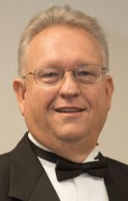
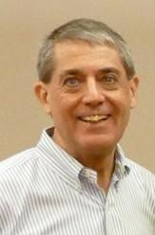
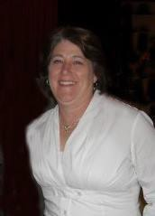
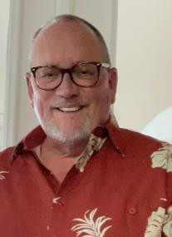
2022-23
Executive Committee
Linda Schoelkopf, Chair, JA Staff Alumni Network
Linda spent a total of more than 40 years doing JA's work. Starting as a four-year Achiever in the JA Company Program, followed by four years as an Advisor in college which led to her first professional role as JA Company Program Director in Rockford, IL. She served as President in Terre Haute, IN, Louisville, Kentucky and completed her career as the CEO in Dallas, Texas. She also served as Director of Training at JA USA for nearly seven years.
John Weil, Immediate Past Chair
John retired as President of Junior Achievement of OKI Partners (Cincinnati) after 40 years of service in December 2016. In high school, John was a student in the JA Company Program winning a scholarship to attend Xavier University. He continued his involvement with JA working for the organization while in college. John officially began his career in 1976 in Cincinnati. He then served in Milwaukee, then returned to Cincinnati. He later worked in the Tampa followed by New Jersey and then back to Tampa. John then returned to his hometown of Cincinnati in 2006 where he served as President.
Frank Evans, Administration
Frank joined the JA Company Program as a high school junior, and then went on to a 38-year JA career. He started in 1971 as Program Manager in Atlantic City, NJ, and went on to Program Director in Hartford, CT and Executive Director in York, PA. Next, he was Regional Assistant and then Regional PB Director in the Denver Regional Office. From 1982 to 2008 he served in various roles at the National Office, starting as National Program Director, which included being NAJAC Conference Director, and most memorably as VP & Executive Assistant to CEO’s Karl Flemke and Jim Hayes. Today, Frank is a Great Clips franchisee in Colorado Springs, CO.
Nancy Finke, Chair, Finance Committee
Nancy joined JA of the OKI Partners, Cincinnati, OH in December 2008 and served as Controller for the organization for nearly 10 years. She served as the field representative for the Controllers Group for three years. She was also a member of the BCRM Users Group for 3+ years. Nancy is currently doing some contract work and stays connected with OKI Partners.
Dennis Gilfoyle, Chair, Fund Development Committee
Since 1984, Dennis Gilfoyle has been helping to impact over 2 million students in western Pennsylvania. Dennis joined Junior Achievement as a Program Director to introduce schools to JA’s first in-classroom program, Project Business. His consistent performance moved him up the ranks to Director of Marketing and then Vice President-Marketing of the Pittsburgh chapter. In 1995, Dennis was named President-Junior Achievement of Florida’s First Coast (Jacksonville) where he managed JA activities in a 31-county area of northeast Florida. In 1997, Dennis returned to Junior Achievement’s Pittsburgh office as Senior Vice President where he served the organization as its chief operating and development officer. In January 2007 Dennis was promoted to President of Junior Achievement of Western Pennsylvania, the largest JA chapter in Pennsylvania and the 15th largest JA Chapter in the U.S. After successfully opening JA BizTown, Dennis retired after a great 36 year career.

Slide 2
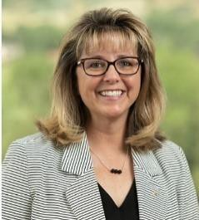
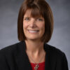
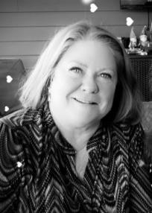
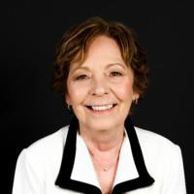
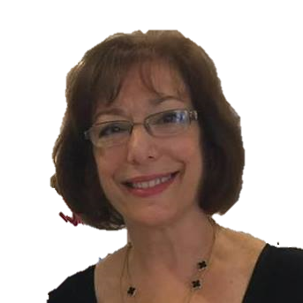
2022-23
Executive Committee
Tami Godsey, Chair, Membership Committee
Tami started her 30 year JA career at the JA National Headquarters in March 1990. Tami held multiple administrative positions mostly with the Operations Group at National. In 1997, Tami joined the JA Southern Colorado, Inc.- Colorado Springs staff as Special Events Director. She returned to the National HQ in 1999 as Administrative Assistant to the National President, Jim Hayes and worked her way through positions and promotions to wrap up the last ten years of her career as Senior Director of Conference and Event Planning coordinating the logistics of the annual National Leadership Conference and many trainings and meetings. Tami is now working with fellow JASAN member Frank Evans at Great Clips as Recruiting Manager.
Theo Boots, Chair, Engagement Committee
Theo began her JA career in 2008 as President of JA of Southwestern Indiana serving counties in Indiana and Illinois. In 2011, she was a finalist for the Karl Flemke award and in 2012, she received the Karl Flemke award which was in recognition of significant achievements and contributions as a new Area Chief Staff Officer. She served as President of the organization until 2016 when she left to serve as Executive Director for the Southwest Chapter of the American Red Cross. Theo is a native of Evansville Indiana and is married and has two adult children and 3 grandchildren. Last year, she retired to watch grandchildren during the school year and still volunteers for JA, the Red Cross, and other organizations in her community.
Sally Stamper, Chair, History Committee
Sally retired in 2002 as President of the JA operation in Norfolk, VA after an eighteen-year JA career. Sally was an Achiever in high school and went on to serve in a number of roles with JA. Prior to serving as President in Norfolk, Sally served as a Manager in both Norfolk, VA and Richmond, VA; Executive Director in Greenville, SC; and Manager in Charlotte, NC. Following her time with Junior Achievement, Sally now works in the Community Management field. Sally stated that JA had a tremendous positive influence on her life and continues to believe in its mission.
Pamela Casteel, Chair, Archives Committee
Pamela joined JA National Headquarters as Editor in Chief in October 2003. In this position she edited the core content of 30 elementary, middle and high school programs. Pamela ensured materials were age appropriate and bias free. She collaborated with production managers, designers, product developers and contractors. Pamela left JA in June 2018 and is a freelance journalist/writer/editor. She volunteers with the Assistance League of Colorado Springs and provides her expertise to them as Volunteer Newsletter Chair.
Lucy O’Donnell, Chair, Staff Development & Recognition Committee
Lucy enjoyed a 27-year career with Junior Achievement of Delaware as a Senior Executive. In that time, she piloted all the classroom-based programs as well as the Capstone programs and served on numerous national committees. Following her JA years, Lucy was the Executive Director of a statewide school for pregnant teens. In her retirement from full time employment, she teaches high school financial literacy programs for a statewide organization, Stand By Me, as well as chairing the Board of Education for the Catholic Diocese of Wilmington.

Slide 3
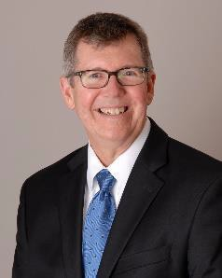
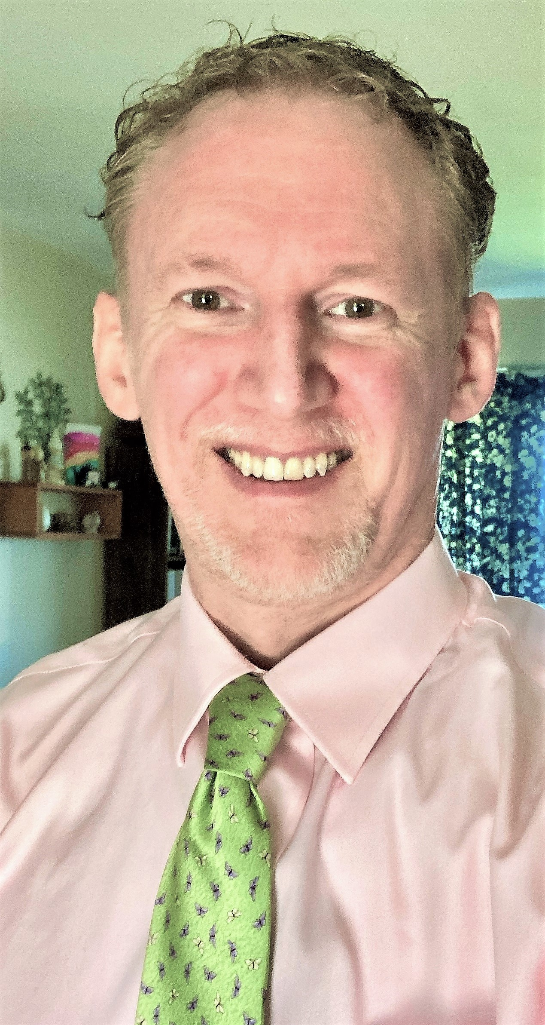
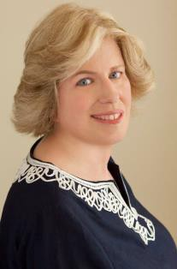
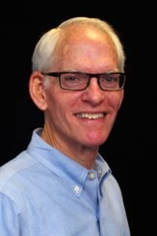
2022-23
Executive Committee
Randal Mays, Chair, Professional Staff Hall of Fame Committee
Randal began his JA career in July 1982 as a Project Business Manager in Shreveport, La. He served as Executive Director of JA of East Texas in Longview then as President of JA of Central Texas in Austin. For the last 19 years, Randal has served as President of JA of the Chisholm Trail in Fort Worth, TX. He was a finalist for the Hook Award and received the Hesselbein How To Be Award.
Randal Co-Chaired the Performance Standards Task Force and was Chair of the HR Committee. Randal retired December 31, 2019, after 36 years of service to the organization.
Greg Munson, At Large member
Greg joined the JA Delaware staff as a Program Manager in January 2000, and was promoted to Director of Programs. While in this position, Greg had the opportunity to work with a variety of National programs, including the launch of JA Titan, along with the pilot cities for JA Enterprise Village/JA Biztown and JA Finance Park. After four years at JA Delaware, he spent another three years at JA of the Delaware Valley, as the Director of Educational Services and oversaw the programs and Exchange City, while continuing to help JA National/JA USA.
With both chapters, he was fortunate to oversee 10 counties (5 from each location). JA Delaware was part of a variety of other pilot programs that Greg helped manage such as Character Rally and Pathfinder. Greg received the 5-year Summit Award and numerous cards and praises from area teachers and students. Greg now serves as the Fundraising, Marketing, and Volunteer Coordinator for West End Neighborhood House where he has been since March 2022, and he looks forward to continuing to work with JASAN and reconnecting with JA Associates.
Laurie Stearn, At Large member
Laurie began her career in September of 1983 in JA of Santa Clara County, CA as Program Manager for the high school program and Business Basics. She was promoted to Senior Educational Services Manager in June,1985, wherein her responsibilities expanded to also include Applied Economics and Project Business. Laurie is an accomplished former Achiever (Lancaster, PA). She won National Secretary of The Year and Outstanding Young Businesswoman at NAJAC in 1979. Over her four years with JA, with the help of some outstanding alumni and volunteers, they built a program that gained national recognition and had the winningest NAJAC delegation year after year. Laurie’s post JA career of 30 years has been focused on marketing and advertising including serving as the director of the Walt Disney Parks & Resorts Online group and running the Midwest division of and leading thought leadership at the American Association of Advertising Agencies (the national trade association of the advertising industry).
Hudson Whitenight, JASAN Secretary
Hud joined the JA Pioneers organization in 2016 when Frank McIntosh, then Chair, determined the need for administrative support for the growing organization. A graduate of the University of Kansas with a Bachelors in English and Psychology, and of Seton Hall University with a Masters in Secondary Education, Hud began his career as a high school English teacher but eventually left spending the remainder of his career in Corporate Leadership Development and Process Improvement. He currently works as an Adjunct teaching English at Wilmington University.

